Slide 1
PGCE English Mentors
7th October 2020
Welcome!

Slide 2
2019-2020 PGCE English Cohort
Cohort = 26 + 1 returner from leave of absence
26/27 awarded PGCE & recommended for QTS including the returner
Jobs
25 gained an NQT post & 1 decided to be a supply teacher initially
  County Durham = 2, Gateshead = 1
  York = 2, North Yorks = 6, East Yorks = 1, Hull = 1
  Leeds = 3, Wakefield = 1, Doncaster = 2, Bradford = 1
  Lincolnshire = 1, Staffordshire = 1,
  Cambridgeshire = 1, Worcestershire = 1,
  London = 1
What a year! - Thank you!

Slide 3
2020-2021 PGCE English Cohort
Cohort = 30
Core = 12
Pathfinder = 10
All Saints = 5
YTSA = 2
Teach North = 1
4 males, 26 females
Oldest trainee is 29 & six trainees are 21/22
6 completed SKEs prior to the PGCE
Politics; Law, Theatre; Sociology; Arabic & French; Philosophy
Many have very little prior school experience
My first impressions: very positive

Slide 4
English PGCE Programme 2020-21
Significant revisions to the University English PGCE course to reflect the newly introduced ITT Core Content Framework
ITT CCF operational from Sept 2020
Defines in detail the minimum curriculum entitlement for all trainee teachers.
Designed to support trainee development in 5 core areas:
      Behaviour management
      Pedagogy
      Curriculum
      Assessment
      Professional behaviours
    N.B. The Teachers’ Standards are still what trainees are assessed against.

Slide 5
English PGCE Programme: Prior to Placement 1
Orientation Establishing a Climate for Learning; You and the National Curriculum for English; Purposeful Professional Practice; English PGCE Assignment 1.
Lesson Planning Introduction to Lesson Planning; Cognitive Load Theory and English; Learning versus Doing; Consolidating Learning in English
Teaching Speaking & Listening The Importance of Speaking and Listening; Using Questions, Group Work and Whole Class Discussions in the English classroom; Teaching Speaking and Listening; Speaking and Listening at GCSE
Teaching Reading Phonics, DARTs & Reading Hooks; The Class Reader; Teaching Literary Analysis; Differentiation in the English Classroom
Teaching Writing Teaching Spelling and Vocabulary; Creative Writing; Introduction to Teaching Writing; Grammar & Punctuation
Teaching Texts Teaching Shakespeare & Canonical Texts at KS3; Teaching Shakespeare & Canonical Texts at KS4; Teaching Poetry (including unseen poetry); GCSE English Language including Non-Fiction Texts

Slide 6
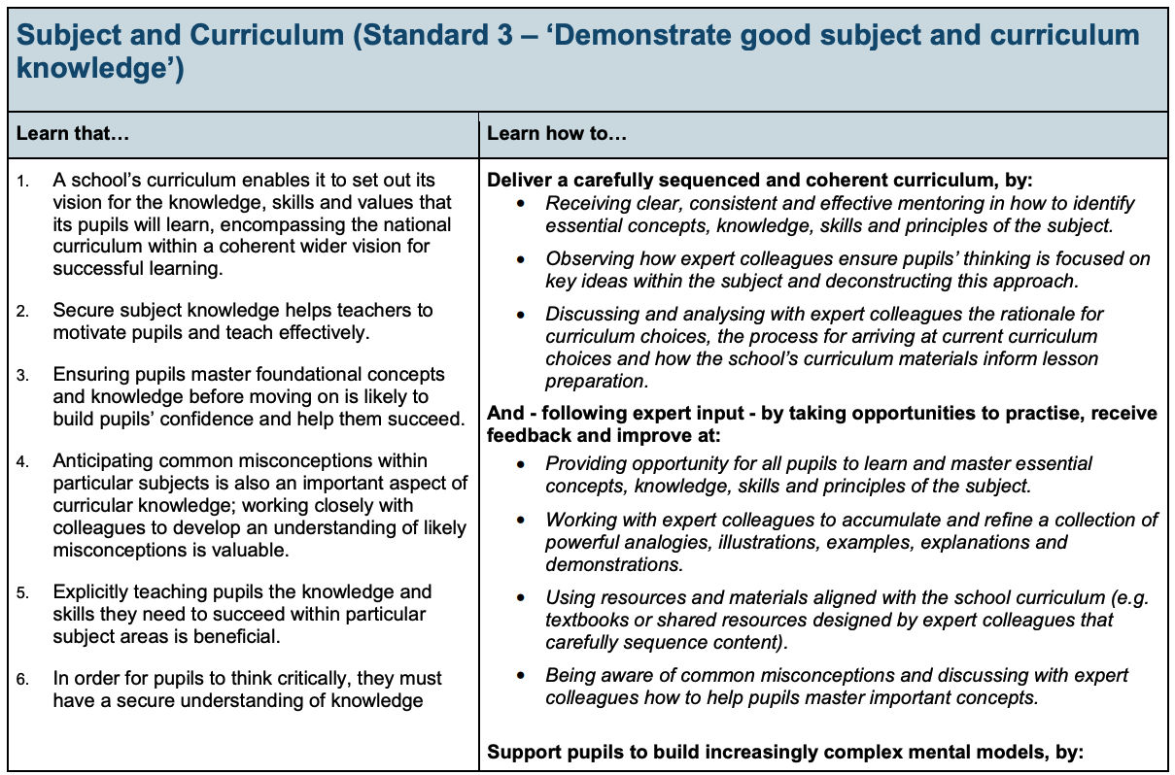
The Core Content Framework for ITT

Slide 7
This year’s course - changes
Reviews/Grading
Pebblepad e-portfolios
Impact of Covid-19 & contingency planning

Slide 8
Support for You
For current mentors
PGCE Administrators: Fiona Jackson & Paisley Bryce: education-pgce-administrator@york.ac.uk
Catherine Shawyer: catherine.shawyer@york.ac.uk
Nicola Towle: nicola.towle@york.ac.uk
Claire Ball-Smith: claire.e.ball-smith@york.ac.uk
Professional Tutor & Fellow Subject Mentors in your school
School Direct Managers

